Slide 1
LINUX VS WINDOWS OPERATING SYSTEM

Slide 2
Welcome To My Presentation
Before get started I would like to thank our honorable faculty SUPTA RICHARD PHILIP to give an opportunity .

Slide 3
Introducing Myself
Name : HASAN, SHADIK
ID NO. : 19-39357-1
Program : BSc IN CSE
American International University-Bangladesh (AIUB)

Slide 4
Contents
Introduction
Windows operating system
Linux operating system
Differences between windows and linux operating systems
Conclusion

Slide 5
Introduction
Operating system
Windows operating system
Linux operating system

Slide 6

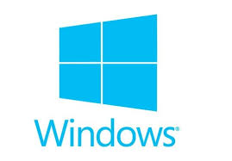
Windows Operating System
About
Work
Use

Slide 7

Linux Operating System
About
Work
Use

Slide 8
Differences Between Windows And Linux Operating Systems
Functions
Security
Software and hardware
Cost and Availability
Latest release and version
[windows 10 (12 November 2019) and Linux kernel 3.0.0 (21 September 2019)]
Comfort

Slide 9
Conclusion
Compare
Best of those two

Slide 10

Any Question
Anyone has any question about this presentation ?

Slide 11
Thank You

